Slide 1


Slide 3
OUR VISION
Our Vision is to provide quality service and education to our pastors by improving our methods, growing our resources, and simplifying our business processes.

Slide 4
RESOLUTIONS
TYPES OF RESOLUTIONS
Sales
Purchases
Refinances
New Construction
Cash Out Loans (Repairs)
Leases
Subleases
Notes:
The Apostolic Assembly Real Estate Department is committed to improving every aspect of the services we provide and building strong relations between our department and the episcopal body. Our commitment to you is:
• To consistently provide timely, professional, effective, and efficient service.
• To identify key needs and assess how we will meet those needs by working towards continuous improvement.
• To demonstrate compassion, understanding, and respect with each interaction.
• To provide the resources and tools necessary to empower our churches to accomplish their real estate goals.

Slide 5
RESOLUTIONS
Financial Requirements: Obtaining a Loan (Purchases, Cash Out, Refinance)
The total annual loan payment amount cannot exceed 30% of the church’s average annual income over the last three years. The average annual income only consists of the tithing and offerings of the local church.
The second requirement is that the Loan-to-Value ratio cannot exceed 65%. This means that your local church cannot borrow more than 65% of the appraised value of the property.
Notes:
The Apostolic Assembly Real Estate Department is committed to improving every aspect of the services we provide and building strong relations between our department and the episcopal body. Our commitment to you is:
• To consistently provide timely, professional, effective, and efficient service.
• To identify key needs and assess how we will meet those needs by working towards continuous improvement.
• To demonstrate compassion, understanding, and respect with each interaction.
• To provide the resources and tools necessary to empower our churches to accomplish their real estate goals.

Slide 6
RESOLUTIONS
Financial Requirements: Leases
The total annual lease payment amount cannot exceed 60% of the church’s average annual income over the last two years. The average annual income only consists of the tithing and offerings of the local church.
If a church is categorized as a New Work, and they do not have 2 years of financial history, then the supervising District, or sponsoring church, will have to sign as Guarantor of the lease, meaning, in the event that the lease goes into default, the Guarantor will be responsible for payments.
Notes:
The Apostolic Assembly Real Estate Department is committed to improving every aspect of the services we provide and building strong relations between our department and the episcopal body. Our commitment to you is:
• To consistently provide timely, professional, effective, and efficient service.
• To identify key needs and assess how we will meet those needs by working towards continuous improvement.
• To demonstrate compassion, understanding, and respect with each interaction.
• To provide the resources and tools necessary to empower our churches to accomplish their real estate goals.

Slide 7
RESOLUTIONS
Guaranteeing a Lease
In order for a District, or sponsoring church, to sign as a Guarantor, they must first obtain a resolution from the majority of either the District Pastors, or the local members and government of the sponsoring church, respectively.
Notes:
The Apostolic Assembly Real Estate Department is committed to improving every aspect of the services we provide and building strong relations between our department and the episcopal body. Our commitment to you is:
• To consistently provide timely, professional, effective, and efficient service.
• To identify key needs and assess how we will meet those needs by working towards continuous improvement.
• To demonstrate compassion, understanding, and respect with each interaction.
• To provide the resources and tools necessary to empower our churches to accomplish their real estate goals.

Slide 8
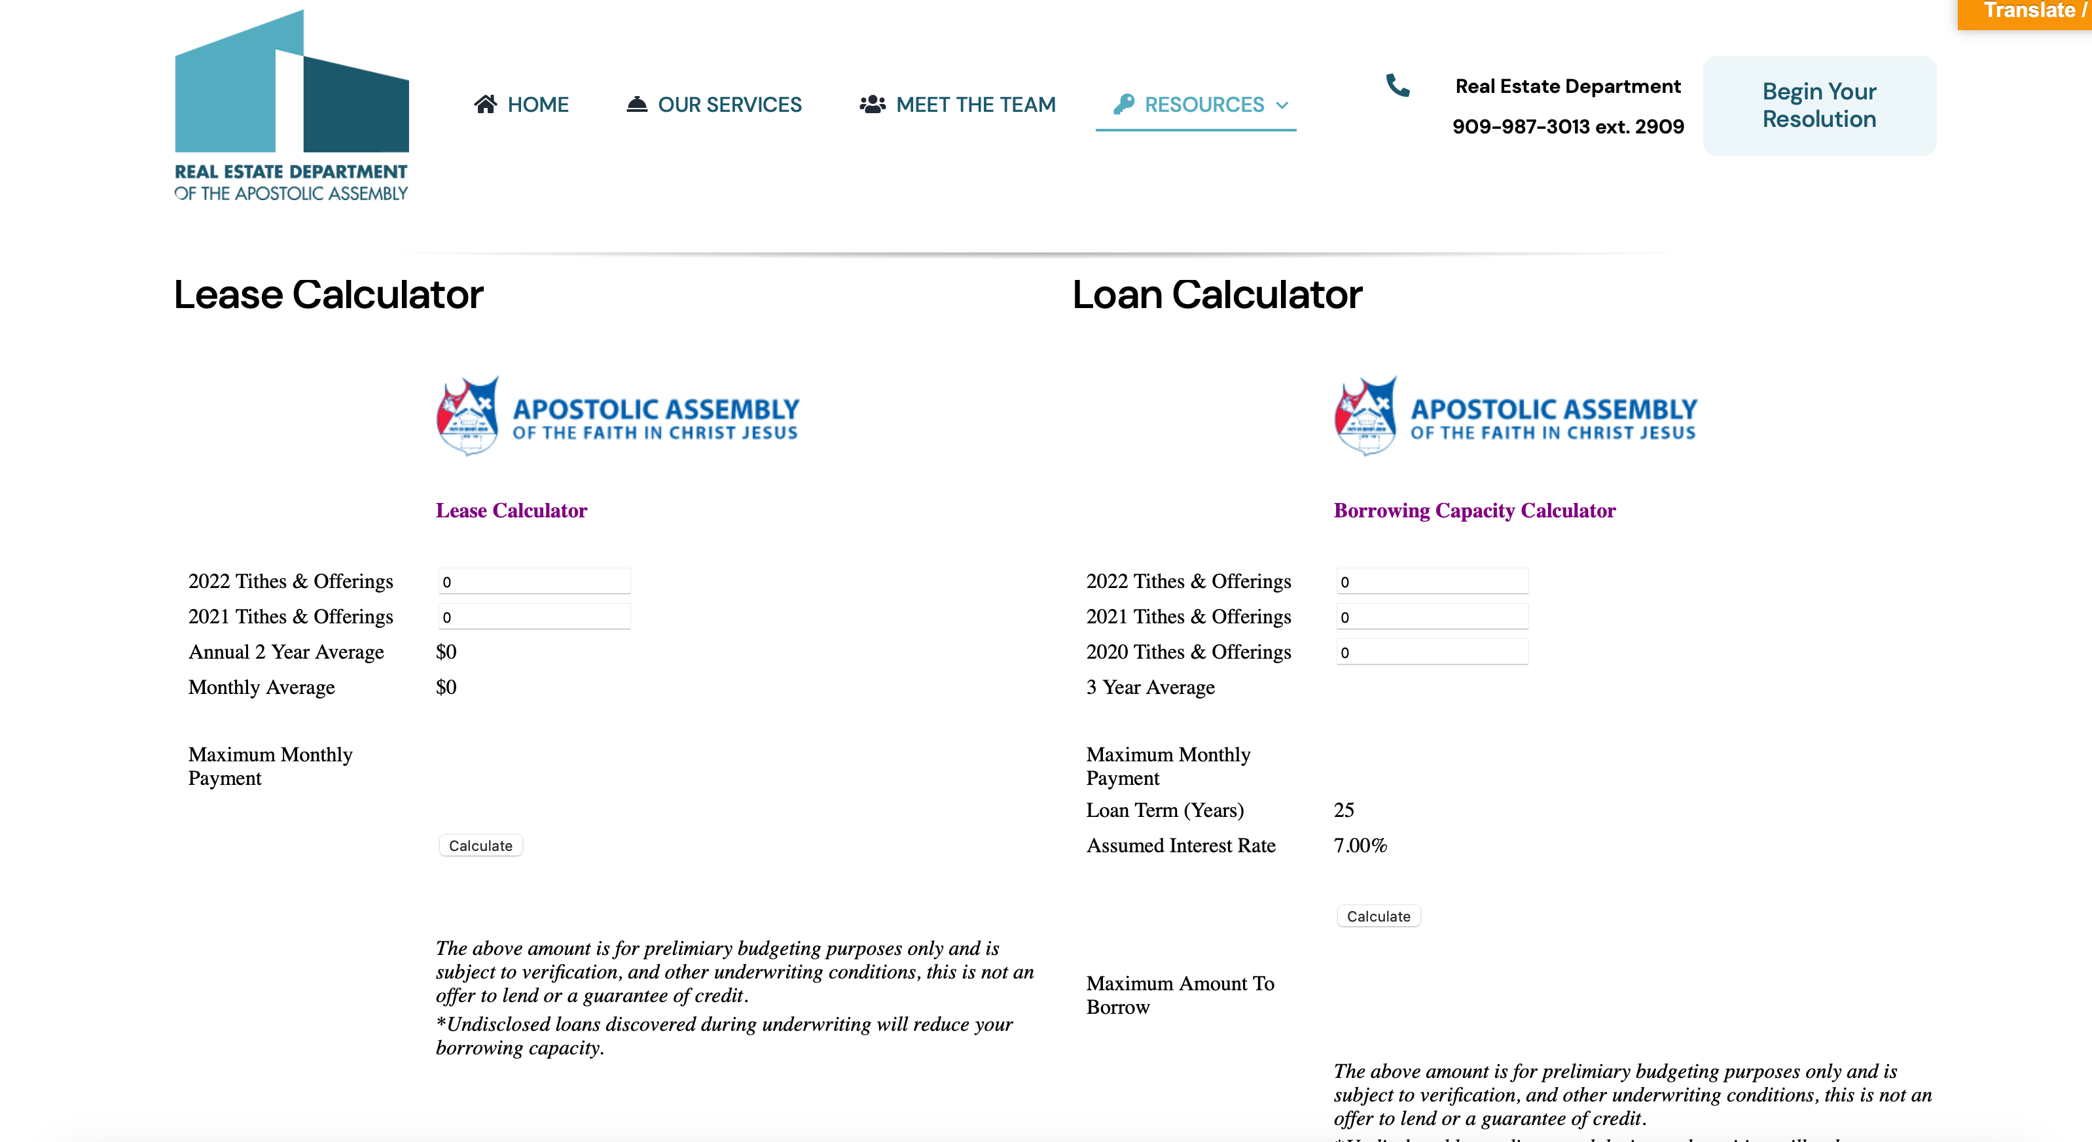
ONLINE CALCULATOR
Notes:
The Apostolic Assembly Real Estate Department is committed to improving every aspect of the services we provide and building strong relations between our department and the episcopal body. Our commitment to you is:
• To consistently provide timely, professional, effective, and efficient service.
• To identify key needs and assess how we will meet those needs by working towards continuous improvement.
• To demonstrate compassion, understanding, and respect with each interaction.
• To provide the resources and tools necessary to empower our churches to accomplish their real estate goals.

Slide 9
RESOLUTION FORMS
Copy the entire text from the resolution template and paste to your District Letterhead.
  If you have a digital District Letterhead template then paste the text directly to your digital file.
  If you do not have a digital District Letterhead template already created, then paste the text directly to a Word document and after completing the rest of the steps below, print out on your District Letterhead paper.
2. Fill in the appropriate and accurate corresponding information that has been presented to you by the local church.
3. Erase the parenthetical prompts listed throughout the template.
Notes:
The Apostolic Assembly Real Estate Department is committed to improving every aspect of the services we provide and building strong relations between our department and the episcopal body. Our commitment to you is:
• To consistently provide timely, professional, effective, and efficient service.
• To identify key needs and assess how we will meet those needs by working towards continuous improvement.
• To demonstrate compassion, understanding, and respect with each interaction.
• To provide the resources and tools necessary to empower our churches to accomplish their real estate goals.

Slide 10
RESOLUTION FORMS
For example, you would fill in the church’s address, but erase the section that says: “(Church Address”)
4. Once complete, the only signature required is the District Secretary’s signature. The signature must be original and cannot be electronic. You scan and email a copy to the real estate team at realestate@apostolicnet.org in order to expedite the resolution process; however, the original must be mailed to headquarters because it is a legal document, “Attn: Real Estate Department” 5401 Citrus Ave, Fontana, CA 92336.
Notes:
The Apostolic Assembly Real Estate Department is committed to improving every aspect of the services we provide and building strong relations between our department and the episcopal body. Our commitment to you is:
• To consistently provide timely, professional, effective, and efficient service.
• To identify key needs and assess how we will meet those needs by working towards continuous improvement.
• To demonstrate compassion, understanding, and respect with each interaction.
• To provide the resources and tools necessary to empower our churches to accomplish their real estate goals.

Slide 11
DEADLINES
The General Board meets the third week of each month.
The Real Estate Department must have completed resolution documentation, including the District Resolution, no later than the first Friday of each month. This allows time for documentation review, and for the Real Estate Administrator to prepare his recommendation to the General Board and for the General Treasurer to review the packet.
If a resolution is incomplete, or missing vital information, then the resolution cannot be presented until the following month.
Notes:
The Apostolic Assembly Real Estate Department is committed to improving every aspect of the services we provide and building strong relations between our department and the episcopal body. Our commitment to you is:
• To consistently provide timely, professional, effective, and efficient service.
• To identify key needs and assess how we will meet those needs by working towards continuous improvement.
• To demonstrate compassion, understanding, and respect with each interaction.
• To provide the resources and tools necessary to empower our churches to accomplish their real estate goals.

Slide 12
APPROVALS & DENIALS
There are three levels of approval that must be given before any documentation can be signed:
Local Resolutions (Government and Member)
District Resolution
Corporate Resolution (General Board Decision)
Notes:
The Apostolic Assembly Real Estate Department is committed to improving every aspect of the services we provide and building strong relations between our department and the episcopal body. Our commitment to you is:
• To consistently provide timely, professional, effective, and efficient service.
• To identify key needs and assess how we will meet those needs by working towards continuous improvement.
• To demonstrate compassion, understanding, and respect with each interaction.
• To provide the resources and tools necessary to empower our churches to accomplish their real estate goals.

Slide 13
APPROVALS & DENIALS
District Boards should not approve a resolution if:
Documentation from the checklist is missing in the resolution packet;
The church does not meet the financial requirements;
The church is not faithful in paying their tithes of tithes;
There is any doubt of the church’s ability to sustain the financial obligations;
A majority vote from the pastors is not received, if the church does not qualify by themselves
Notes:
The Apostolic Assembly Real Estate Department is committed to improving every aspect of the services we provide and building strong relations between our department and the episcopal body. Our commitment to you is:
• To consistently provide timely, professional, effective, and efficient service.
• To identify key needs and assess how we will meet those needs by working towards continuous improvement.
• To demonstrate compassion, understanding, and respect with each interaction.
• To provide the resources and tools necessary to empower our churches to accomplish their real estate goals.

Slide 14
APPROVALS & DENIALS
The final decision is given by the General Board of Directors. After a decision is made:
The Real Estate Department will draft a Corporate Resolution and send to the pastor and Cc’ the District General Board;
The Real Estate Department will coordinate with all associated parties (lenders, escrow companies, landlords, etc.) to initiate the signing of required documentation;
The decision is final, unless overturned by a new Corporate Resolution.
Notes:
The Apostolic Assembly Real Estate Department is committed to improving every aspect of the services we provide and building strong relations between our department and the episcopal body. Our commitment to you is:
• To consistently provide timely, professional, effective, and efficient service.
• To identify key needs and assess how we will meet those needs by working towards continuous improvement.
• To demonstrate compassion, understanding, and respect with each interaction.
• To provide the resources and tools necessary to empower our churches to accomplish their real estate goals.

