Slide 1


Slide 2



Two Organizations…One Mission:
Build The Church
Repent and be baptized every one of you in the name of Jesus Christ for the forgiveness of your sins, and you will receive the gift of the Holy Spirit

Slide 3
Mission Barricades
1. Availability of Church Properties
2. Construction Delays
3. Economic Headwinds Facing Ministries and Lenders

Slide 4
Mission Barricades
1. Availability of Church Properties
Up to 100,000 Christian church properties will be sold or repurposed in the next decade,…That's a quarter to a third of all churches in the United States. (quote from Mark Elsdon printed in Philadelphia Tribune, Jan 26, 2024)

Slide 5
Mission Barricades
2. Construction Delays
Fewer construction workers in the US
Supply Chain Problems
Inflation leading to cost overruns
Additional City and County Bureaucracy

Slide 6
Mission Barricades
Economic Headwinds
Anticipation of a Downturn
Current Rate Environment
Tightened Liquidity Tolerances

Slide 7
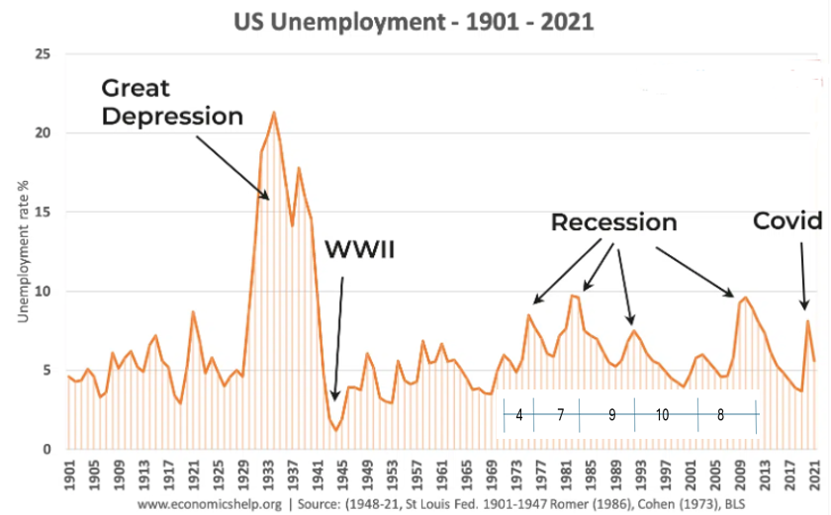
Mission Barricades
Economic Headwinds
Anticipation of a Downturn

Slide 8
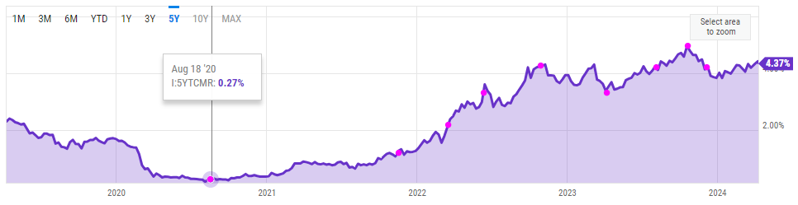
Mission Barricades
Economic Headwinds
Current Rate Environment (5 year CMT)

Slide 9
Mission Barricades
Economic Headwinds
Tightened Liquidity Tolerances
Banks with assets below $100 billion, when detailing reasons for tighter lending, “more frequently cited concerns about deposit outflows, funding costs, deterioration in or desire to improve their liquidity positions and concerns about declines in the market value of fixed-income assets,” the Fed said. (The central bank surveyed 62 domestic banks and 19 U.S. branches and agencies of foreign banks between Sept. 25 and Oct. 5)

Slide 10
Breaching the Barricades: Demand for Church Property
Availability of Church Properties
Prepare to move from being a renter to an owner
Think creatively on utilizing non-traditional church buildings
If selling is the best option, try to find a ministry to sell to
Leverage Property Demand- Rent unused property

Slide 11
Breaching the Barricades: Construction Delays
2. Construction Delays
Look first to renovate, rather than ground up construction
Engage experienced help early in the process
Don’t build to grow; build because your growing
Make wise and counseled promises on target dates

Slide 12
Breaching the Barricades: Changing Economy
Economic Headwinds
Prepare for a Downturn: Have cash reserves in place
Genesis 41:47-19 (⁴⁷ During the seven years of abundance the land produced plentifully. ⁴⁸ Joseph collected all the food produced in those seven years of abundance in Egypt and stored it in the cities. In each city he put the food grown in the fields surrounding it. ⁴⁹ Joseph stored up huge quantities of grain, like the sand of the sea; it was so much that he stopped keeping records because it was beyond measure.)
Current Rate Environment: Be a Top Tier Borrower
Tightened Liquidity Tolerances: Leverage Your Deposits

Slide 13
Two Organizations…Working Together:
Prepare to Own: Leverage the ACCU/Apostolic Assembly Relationship
Informed Underwriting recognizing the strength of the denomination
Can be considered a top tier borrower regardless of local church size
Construction Planning: Lean on ACCU’s 30+ years of Church Construction
Preparing for Economic Headwinds: Utilize ACCU’s High Yield Savings
Repent and be baptized every one of you in the name of Jesus Christ for the forgiveness of your sins, and you will receive the gift of the Holy Spirit

Slide 14
Two Organizations…Working Together:
What Questions do you have?
Repent and be baptized every one of you in the name of Jesus Christ for the forgiveness of your sins, and you will receive the gift of the Holy Spirit

