Slide 1


Slide 2

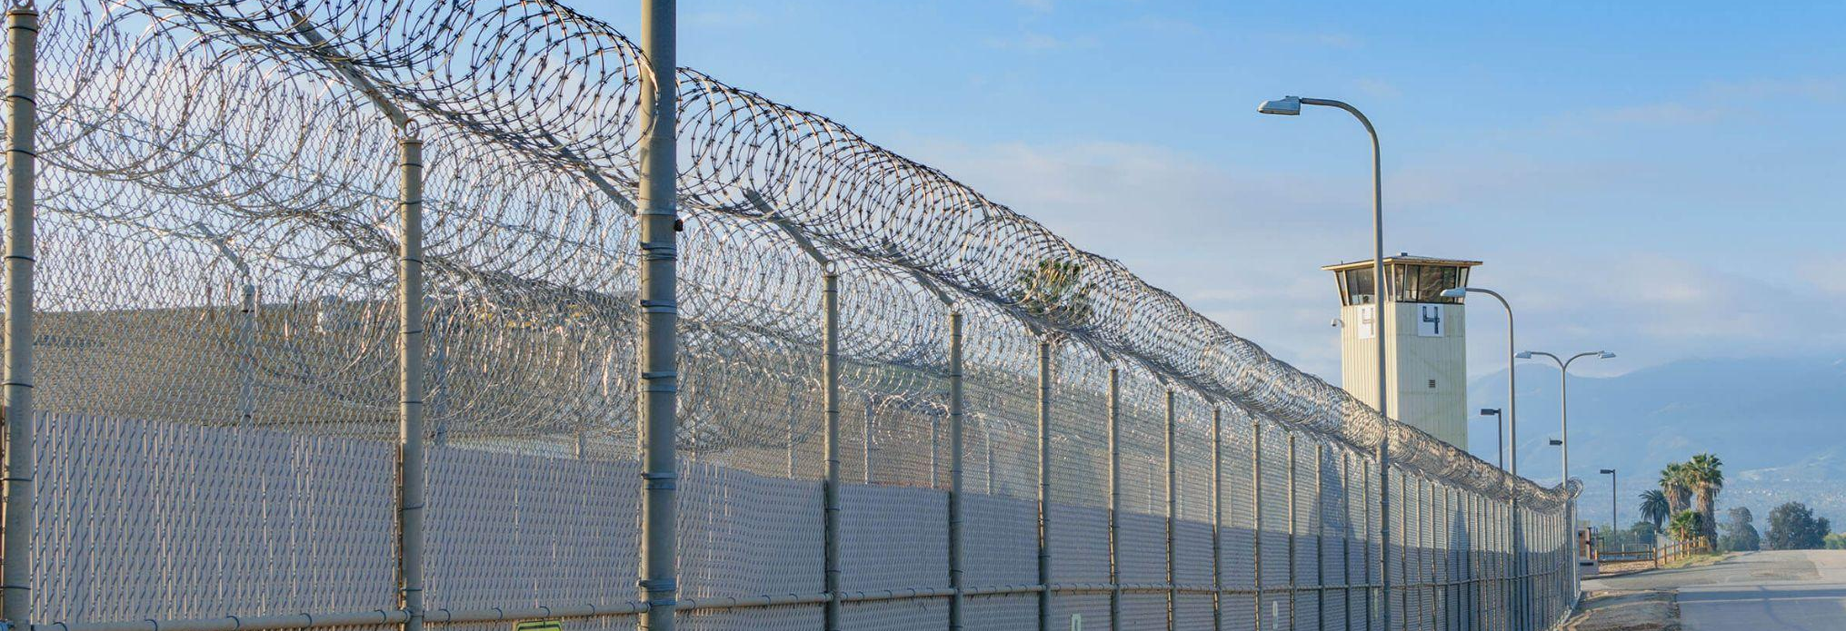
BEHIND THE WALLS
Prison Ministry • The Strategy of Jesus • The Gap the Church Must Close

Slide 3
A QUESTION
Someone in this room lives within
30 minutes of a county jail.
The people inside cannot leave to come to your church.
They are waiting for someone to walk through the door.
Has the Apostolic church decided to walk through that door — or not?

Slide 4
THE FIELD
The Mission Field Is Already Gathered
~2M
95%
70%
~50%
People incarcerated
in U.S. prisons
and jails today
Will be released
and return to
your community
Of federal inmates
claim a religious
preference
California’s
recidivism rate
over 10 years

Slide 5
“Then Jesus answering said unto them,
Go your way, and tell John
what things ye have seen and heard;
how that the blind see, the lame walk,
the lepers are cleansed, the deaf hear,
the dead are raised, to the poor
the gospel is preached.”
Luke 7:22

Slide 6
The Church Is Not in the Room
3,116
local and county jails in the U.S. Most are within driving
distance of an Apostolic congregation.
Voluntary
Incarcerated persons must opt in to religious services.
The church waits to be invited.
No anchor
Without a consistent outside presence, there is nothing to
connect a person to when they walk out the gate.

Slide 7
Two Methods. One Mission.
GROUP STUDY
ONE-ON-ONE
The “Preaching” Model
The “Discipleship” Model
Chapel or approved group space
Personal visit or correspondence
Worship, teaching, prayer,
fellowship, evangelism
Strategy of Jesus Levels 1–4
delivered directly
Approved once per week per
Title 15 §3044
Follows the person if they
transfer institutions
Seed planted in the corporate setting
Mirrors how Jesus called
each disciple individually

Slide 8
Incarceration Fractures Families
Effective ministry doesn’t stop at the cell door.
51%
Children
Of incarcerated men are fathers.
Every one is a family system in crisis.
Of incarcerated parents are significantly
more likely to be incarcerated themselves.
Spouses
The Church
Navigate legal systems, finances, and
parenting alone — often without community.
Is uniquely equipped to be present for
both the incarcerated AND the family.

Slide 9
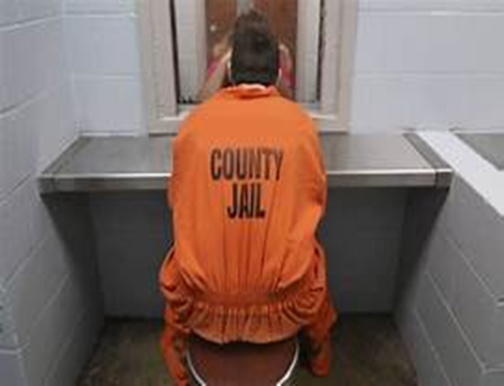
A TESTIMONY
A Father. A Son. A Second Chance.

Slide 10

A TESTIMONY
Solitary Confinement.
Where God Still Reaches.
[Presenter shares the testimony of the young man and his father]

Slide 11
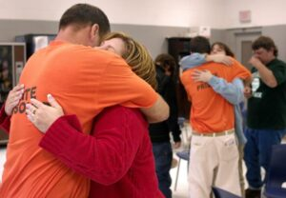
A TESTIMONY
A Loved One Walks Through the Door.

Slide 12
“Can you help me find a church?”
— An incarcerated person, days from release
They are not asking for a resource list.
They are asking whether anyone on the outside is expecting them.
That question — and whether there is an answer — is the gap
the Apostolic Jail Ministry exists to close the gap.

Slide 13
What if…
What if the Apostolic Assembly had people
inside every tier of this system —
Not as volunteers who show up once a month — but as authorized,
credentialed, institutionally recognized ministers.
People who sit at the table when policy decisions are made.
People who carry the full weight of the AAOFCJ behind them
into those spaces every single day.
People the institution cannot ignore — because the law requires
them to be there.

Slide 14
The AAOFCJ currently has
0
formally endorsed chaplains.
Even though the Federal Bureau of Prisons already
recognizes “Apostolic/Non-Trinitarian” as a formal category.
Something is being built. If you want to know what it looks like — come find us.

Slide 15
The Tool Already Exists in Your Church
The Strategy of Jesus Simplified — three gears your church already runs:
1
Evangelistic Cycle
5 weeks: Identify → Contact → Visit → Invite → Bring.
Inside: 10 people live in housing unit.
2
Cell Group
Approved service: Worship, Discipleship, Ministry, Fellowship, Evangelism.
Consistency is the most powerful message you can send.
3
Discipleship School
Levels 1–4 by correspondence.
Follows the person when they transfer. No access required.

Slide 16
The sentence isn’t finished yet.
Come finish it with us.
GO IN
WRITE
RECEIVE
CHAMPION
Volunteer at a facility.
We walk you through every step.
Correspondence discipleship.
No access required.
Welcome released people
by name. Before they arrive.
District & national leaders.
APM needs your reach.
APM BOOTH IN THE LOBBY • QUESTIONS • COMMITMENT • DONATIONS • FIND OUT MORE
Apostolic Prison Ministry • AAOFCJ National Missions Event • April 25

Slide 17


