Slide 1

National Secretaries Workshop
Protecting the Mission of the Church
Bishop Felipe A. Salazar

Slide 2
The Foundation
The Church Has a Mission. It Must Be Protected
The Great Commission
A Mission Under Threat
"Go therefore and make disciples of all nations, baptizing them in the name of the Father and of the Son and of the Holy Spirit."— Matthew 28:19 (ESV)
Every great mission faces opposition. Legal vulnerabilities, administrative failures, record-keeping gaps, and distracted leadership can derail even the most Spirit-led congregation.
The Church does not exist for itself. It exists to fulfill the mandate of Jesus Christ, to reach the lost, make disciples, and advance the Kingdom of God.
The role of the church secretary or administrator is not peripheral; it is prophylactic. You are the first line of defense that keeps the mission moving forward, unhindered and protected.

Slide 3
A Symbiotic Relationship
A symbiotic relationship is a close, ongoing interaction between two different organisms in which both benefit from each other's presence and contribution.
Mutual Benefit
Interdependence
Harmony of Roles
Both parties gain something valuable from the partnership.
Each relies on the other in meaningful, complementary ways.
Each fulfills a distinct function — neither replaces the other.
The clownfish and sea anemone illustrate this perfectly: the anemone protects the clownfish from predators; the clownfish cleans the anemone and circulates water. Alone, each is vulnerable. Together, they thrive, just as Moses and Jethro, and just as pastor and administrator.
Notes:
Key Elements of a Symbiotic Relationship:
Mutual benefit – both parties gain something valuable
Interdependence – each relies on the other in some way
Harmony of roles – each fulfills a distinct function
Example: In nature, a symbiotic relationship is one in which two different organisms live and work together in such a way that both benefit and flourish. One of the clearest examples is the partnership between the clownfish and the sea anemone. The anemone, with its stinging tentacles, provides protection for the clownfish from predators, while the clownfish, in return, cleans the anemone, removes parasites, and even helps circulate water to keep it healthy. Alone, each is vulnerable; together, they thrive.
This illustrates the relationship between Moses and Jethro.
Moses carried the divine calling, the vision, and the authority to lead Israel,
Jethro brought the wisdom and administrative structure that made that calling sustainable.
One provided direction, the other provided organization, and together, they created a system that brought peace to the people and endurance to the leader.
In the same way, when a pastor and his administrators function in a healthy, symbiotic relationship, the church is not only protected, it prospers, grows, and fulfills the mission of God.

Slide 4
Administration Is a Gift of the Holy Spirit
Many believers view administration as a secular function. Scripture teaches otherwise. God himself ordains the gift of administration for the health of His Church.
1 Corinthians 12:28
Romans 12:8
Exodus 18:21
"And God has appointed in the church first apostles, second prophets, third teachers, then miracles... administrations, and various kinds of tongues." Administration is listed among the spiritual gifts, appointed by God Himself for the ordering of His Church.
"...the one who leads, with diligence." Diligence, careful, thorough, attentive work, is the hallmark of godly administration. It is not merely competence; it is a spiritual calling exercised with excellence.
Jethro counseled Moses: "Select capable men from all the people, men who fear God, trustworthy men who hate dishonest gain, and appoint them as officials." The first organizational structure in redemptive history was built on character-driven administration.

Slide 5
The Moses & Jethro Model
Moses
Jethro
Carried the divine calling, the vision, and the authority to lead Israel. He provided direction.
Brought wisdom and administrative structure that made the calling sustainable. He provided organization.
Together, they created a system that brought peace to the people and endurance to the leader. When a pastor and his administrators function in a healthy, symbiotic relationship, the church is not only protected, it prospers, grows, and fulfills the mission of God.
"Where there is no guidance, a people falls, but in an abundance of counselors there is safety." Proverbs 11:14

Slide 6


The Relationship: Mutual Respect
Jethro, though not leading the Israelites, offered wisdom to Moses, and Moses received it with humility and honor. In today's church, administrators are not the shepherd, but they are vital partners who help the pastor carry the weight of leadership.
"So Moses went out to meet his father-in-law, bowed down, and kissed him." Exodus 18:7
This moment models the posture every pastor-administrator relationship requires: mutual respect, trust, and a spirit of mentorship.
Notes:
THE RELATIONSHIP:
Jethro, though not leading the Israelites, offered wisdom to Moses. In today’s church, administrators are not the shepherd, but they are vital partners, helping the pastor carry the weight of leadership.
Exodus 18:7: “So Moses went out to meet his father-in-law, bowed down, and kissed him.” “Y Moisés salió a recibir a su suegro, y se inclinó, y lo besó; y se preguntaron el uno al otro cómo estaban, y vinieron a la tienda.”
(Acknowledge the relationship of mutual respect and mentorship.)
Proverbs 11:14: “Where there is no guidance, a people falls, but in an abundance of counselors there is safety.” “Donde no hay dirección sabia, caerá el pueblo; Mas en la multitud de consejeros hay seguridad.”

Slide 7
Catching the Vision: The Secretary as a Vision Partner
The Pastor carries the vision. But a vision unorganized is merely a dream. The church administrator's first and highest calling is to understand, internalize, and operationalize the Pastor's vision translating it from inspiration into implementation.
Understand the Vision
Document the Vision
Write it down. Capture decisions, goals, and plans in writing so the vision is preserved beyond any single conversation.
Meet regularly with your Pastor. Ask clarifying questions. Know the "why" behind every initiative.
"Where there is no vision, the people perish: but he that keepeth the law, happy is he." Proverbs 29:18 (KJV)
Notice the second half: "he that keepeth the law." Keeping, maintaining, preserving, upholding is the administrator's sacred task. The vision lives or dies by the quality of its stewards.
Advance the Vision
Coordinate ministries, schedules, and resources so that every part of the church body is aligned with the Pastor's direction.

Slide 8

Observing the Burden
Jethro saw Moses overwhelmed sitting alone from morning to evening, bearing the weight of an entire nation. Pastors today face the same reality: preaching, counseling, guiding, and managing operations. Without support, they risk burnout or distraction from their divine calling.
"What is this that you are doing for the people? Why do you sit alone?" Exodus 18:14
"Bear one another's burdens, and so fulfill the law of Christ." Galatians 6:2
Notes:
Jethro saw Moses overwhelmed. Pastors today bear spiritual burdens, preaching, counseling, guiding—but also administrative ones. Without support, they risk burnout or distraction from their calling.
Exodus 18:14: “When Moses’ father-in-law saw all that he was doing for the people, he said, ‘What is this that you are doing for the people? Why do you sit alone?’” “Viendo el suegro de Moisés todo lo que él hacía con el pueblo, dijo: ¿Qué es esto que haces tú con el pueblo? ¿Por qué te sientas tú solo, y todo el pueblo está delante de ti desde la mañana hasta la tarde?”
(Recognize the overwhelming burden pastors face alone.)
Galatians 6:2: “Bear one another’s burdens, and so fulfill the law of Christ.” “Sobrellevad los unos las cargas de los otros, y cumplid así la ley de Cristo.”

Slide 9
Freeing the Pastor to Lead
The Acts 6 Principle
In Acts 6:1–4, the early church faced a crisis: widows were being neglected in the daily distribution of food. The apostles' response was not to work harder it was to delegate wisely.
"It would not be right for us to neglect the ministry of the word of God in order to wait on tables. Brothers and sisters, choose seven men from among you who are known to be full of the Spirit and wisdom. We will turn this responsibility over to them and will give our attention to prayer and the ministry of the word.” Acts 6:2–4 (NIV)
The deacons, administrators of practical ministry, were appointed so that the apostles could focus on their primary calling. Your work sets the Pastor free. Every task you handle with excellence is a task the Pastor does not have to carry. This is not support work; this is Kingdom strategy.

Slide 10
Advice & Delegation
Jethro's counsel was clear: delegate to capable, trustworthy leaders. For pastors, this means trusting administrators to manage finance, logistics, and operations, freeing the pastor to focus on spiritual leadership.
Mutual Respect
Shared Vision
Accountability
The pastor leads; the administrator advises. Both honor each other's role.
Both pastor and administrator work toward the same God-given mission.
Transparency and trust are the foundation of effective delegation.
"Pick out from among you seven men of good repute... but we will devote ourselves to prayer and the ministry of the word." Acts 6:3-4
Notes:
Jethro’s advice, delegate to capable leaders. For pastors, this means trusting administrators to manage areas of finance, logistics, or operations. Key principles include mutual respect—the pastor leads, the administrator advises. Shared vision ensures both work toward the same mission, and accountability fosters transparency.
Exodus 18:21: “Moreover, look for able men from all the people... and let them judge the people at all times.” “Además escoge tú de entre todo el pueblo varones de virtud, temerosos de Dios, varones de verdad, que aborrezcan la avaricia; y ponlos sobre el pueblo por jefes de millares, de centenas, de cincuenta y de diez.”
(Jethro advises delegation of tasks.)
Acts 6:3-4: “Therefore, brothers, pick out from among you seven men of good repute... but we will devote ourselves to prayer and the ministry of the word.” “Buscad, pues, hermanos, de entre vosotros a siete varones de buen testimonio, llenos del Espíritu Santo y de sabiduría, a quienes encarguemos de este trabajo. Y nosotros persistiremos en la oración y en el ministerio de la palabra.”

Slide 11
Healthy Leadership Structures
A strong organizational structure protects the pastor from overload and the church from legal or operational gaps. When roles are clearly defined, efficiency grows and the church is safeguarded. Administrators handle legal compliance and operational details, allowing the pastor to remain focused on spiritual leadership.
"If you do this, God will direct you, you will be able to endure, and all this people also will go to their place in peace." Exodus 18:23
"But all things should be done decently and in order." 1 Corinthians 14:40
Notes:
A strong structure protects the pastor from overload and the church from legal or operational gaps. When roles are clear, efficiency grows, and the church is safeguarded, administrators help with legal compliance, allowing the pastor to focus on spiritual leadership.
Exodus 18:23: “If you do this, God will direct you, you will be able to endure, and all this people also will go to their place in peace.” “Si esto hicieres, y Dios te lo mandare, tú podrás sostenerte, y también todo este pueblo irá en paz a su lugar.”
(Healthy structures lead to sustainability and peace.)
1 Corinthians 14:40: “But all things should be done decently and in order.” “Pero hágase todo decentemente y con orden.”

Slide 12

Protecting the Church Legally
The Church exists in the world, and the world has laws. A legally vulnerable church is a distracted church one whose mission can be interrupted, its resources drained, and its testimony damaged by preventable legal crises. Legal protection is spiritual protection.
Corporate Compliance
Employment Law
Maintain current nonprofit registration, annual state filings, and IRS 501(c)(3) compliance. Lapsed status exposes the church to taxation and donors to lost deductions.
Ensure proper classification of employees vs. contractors. Maintain up-to-date personnel files, signed policies, and documented performance reviews for all staff.
Insurance Coverage
Safeguarding Policies
Review general liability, property, directors & officers, and abuse liability policies annually. Gaps in coverage can devastate a congregation's finances in one incident.
Implement and enforce background check protocols, two-adult rules, and documented child protection policies. These are both legal requirements and moral imperatives.
Legal vulnerability is not a spiritual problem; it is an administrative one. The enemy uses preventable legal crises to pull churches off mission.

Slide 13
The Ministry of Record-Keeping
Scripture on Faithful Record-Keeping
What Must Be Recorded and Why
"A faithful man will abound with blessings, but whoever hastens to be rich will not go unpunished." Proverbs 28:20 (ESV)
Board & Business Meeting Minutes
Minutes are the legal memory of the church. Decisions without documentation can be challenged, misremembered, or disputed in legal proceedings.
Faithfulness in the small things, the minutes, the membership rolls, the financial ledgers, is an act of worship. It is faithfulness that opens the door to greater Kingdom trust.
Membership Records
Accurate membership rolls protect voting integrity, support pastoral care, and satisfy denominational reporting requirements.
Financial Records
"Whoever can be trusted with very little can also be trusted with much." Luke 16:10 (NIV)
Every donation, expense, and audit trail must be preserved. Transparency in finances protects the Pastor, the board, and the church's integrity before the community.
Correspondence & Contracts
Agreements with vendors, staff, and ministry partners should be documented and filed systematically — not stored in someone's inbox or memory.

Slide 14
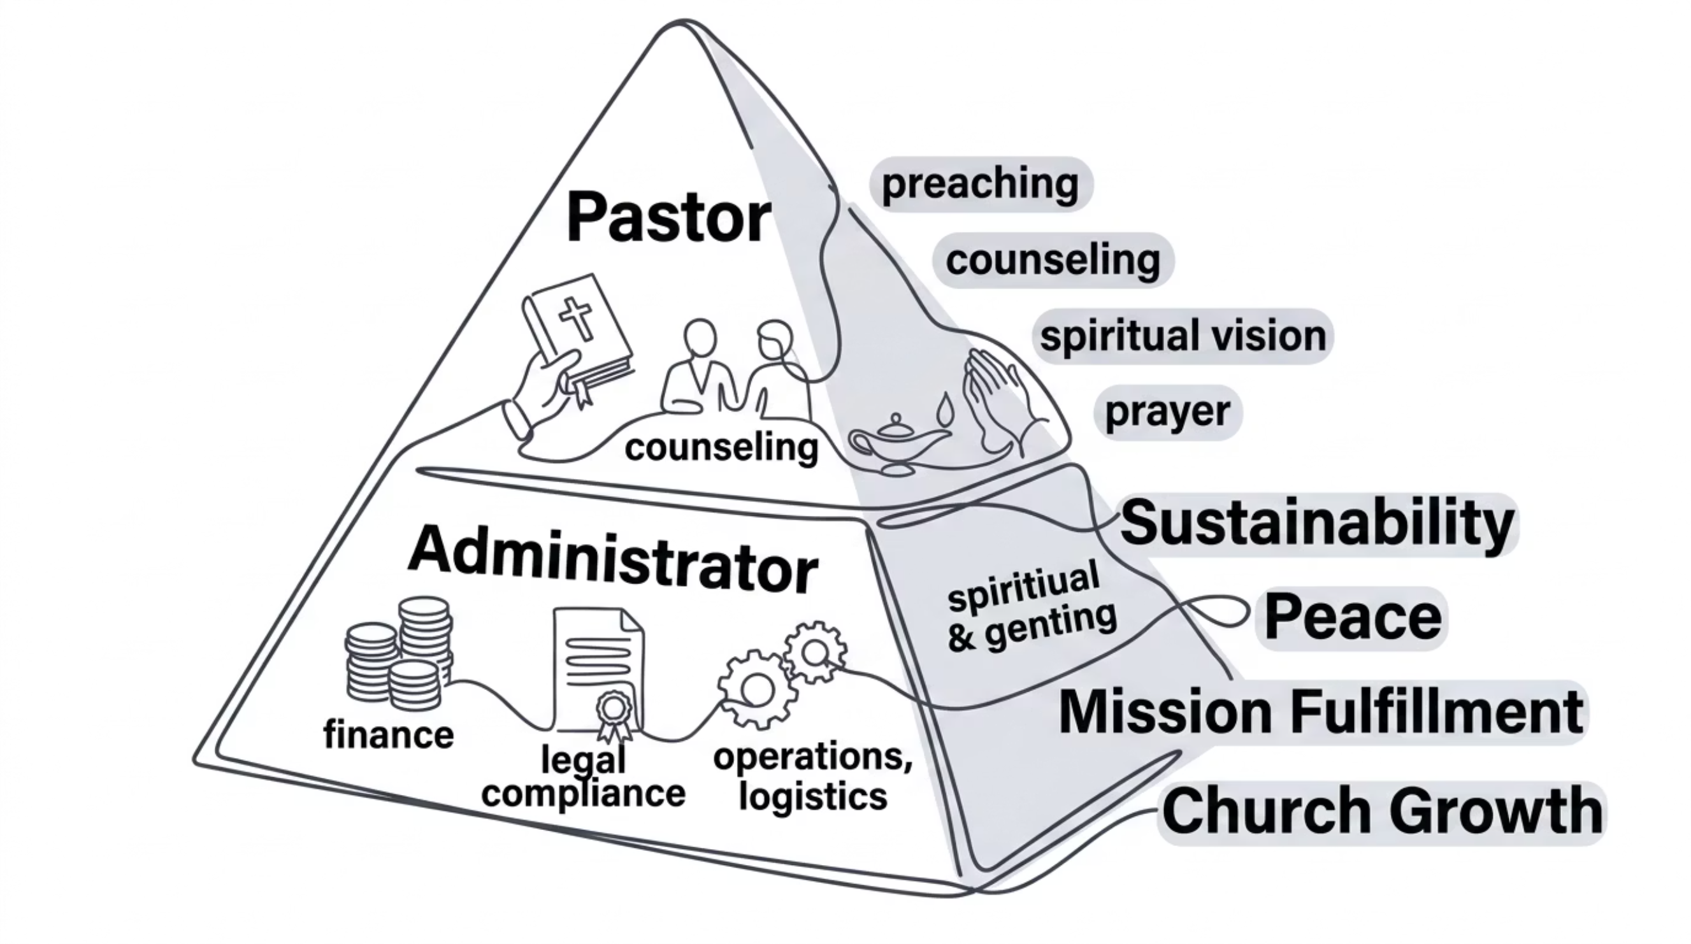

The Structure at a Glance
When each role is honored and clearly defined, the entire body of Christ benefits. The pastor endures, the people find peace, and the mission of God advances without compromise.

Slide 15
Practical Application
01
02
Identify Administrative Partners
Delegate Wisely
Seek out capable, trustworthy individuals of good repute who share the church's vision and values.
Assign clear responsibilities in finance, operations, and logistics, freeing the pastor for spiritual focus.
03
04
Trust the Structure
Equip the Saints
Like Moses, listen and implement. A humble leader who receives counsel builds a sustainable ministry.
Recognize that God gave the church apostles, prophets, pastors, and teachers to build up the body together.
"So Moses listened to the voice of his father-in-law and did all that he had said." Exodus 18:24
Notes:
Pastors can begin by identifying administrative partners, delegating wisely, and trusting the structure. This ensures the church thrives, while the pastor remains focused on the divine calling.
Exodus 18:24: “So Moses listened to the voice of his father-in-law and did all that he had said.” “Y oyó Moisés la voz de su suegro, e hizo todo lo que dijo.”
(Action: Moses implements the advice.)
Ephesians 4:11-12: “And he gave the apostles, the prophets, the evangelists, the shepherds and teachers, to equip the saints for the work of ministry, for building up the body of Christ.” “Y él mismo constituyó a unos, apóstoles; a otros, profetas; a otros, evangelistas; a otros, pastores y maestros, a fin de perfeccionar a los santos para la obra del ministerio, para la edificación del cuerpo de Cristo.”

Slide 16
Standing Guard: The Administrator as Watchman
"Son of man, I have made you a watchman for the people of Israel; so hear the word I speak and give them warning from me.” Ezekiel 3:17 (NIV)
The prophet Ezekiel was assigned as a watchman one who sees threats before they arrive and warns the community in time to respond. Church administrators serve a parallel function. You are positioned to see what others cannot: the unsigned contract, the expired policy, the unminuted decision, the missing financial safeguard.
Anticipate
Alert
Resolve
Review compliance deadlines, policy renewals, and regulatory requirements proactively — before they become crises.
Bring concerns to leadership promptly and clearly. A watchman who sees danger but stays silent has failed their post.
Where possible, act within your authority to close gaps and correct deficiencies before they require pastoral intervention.

Slide 17
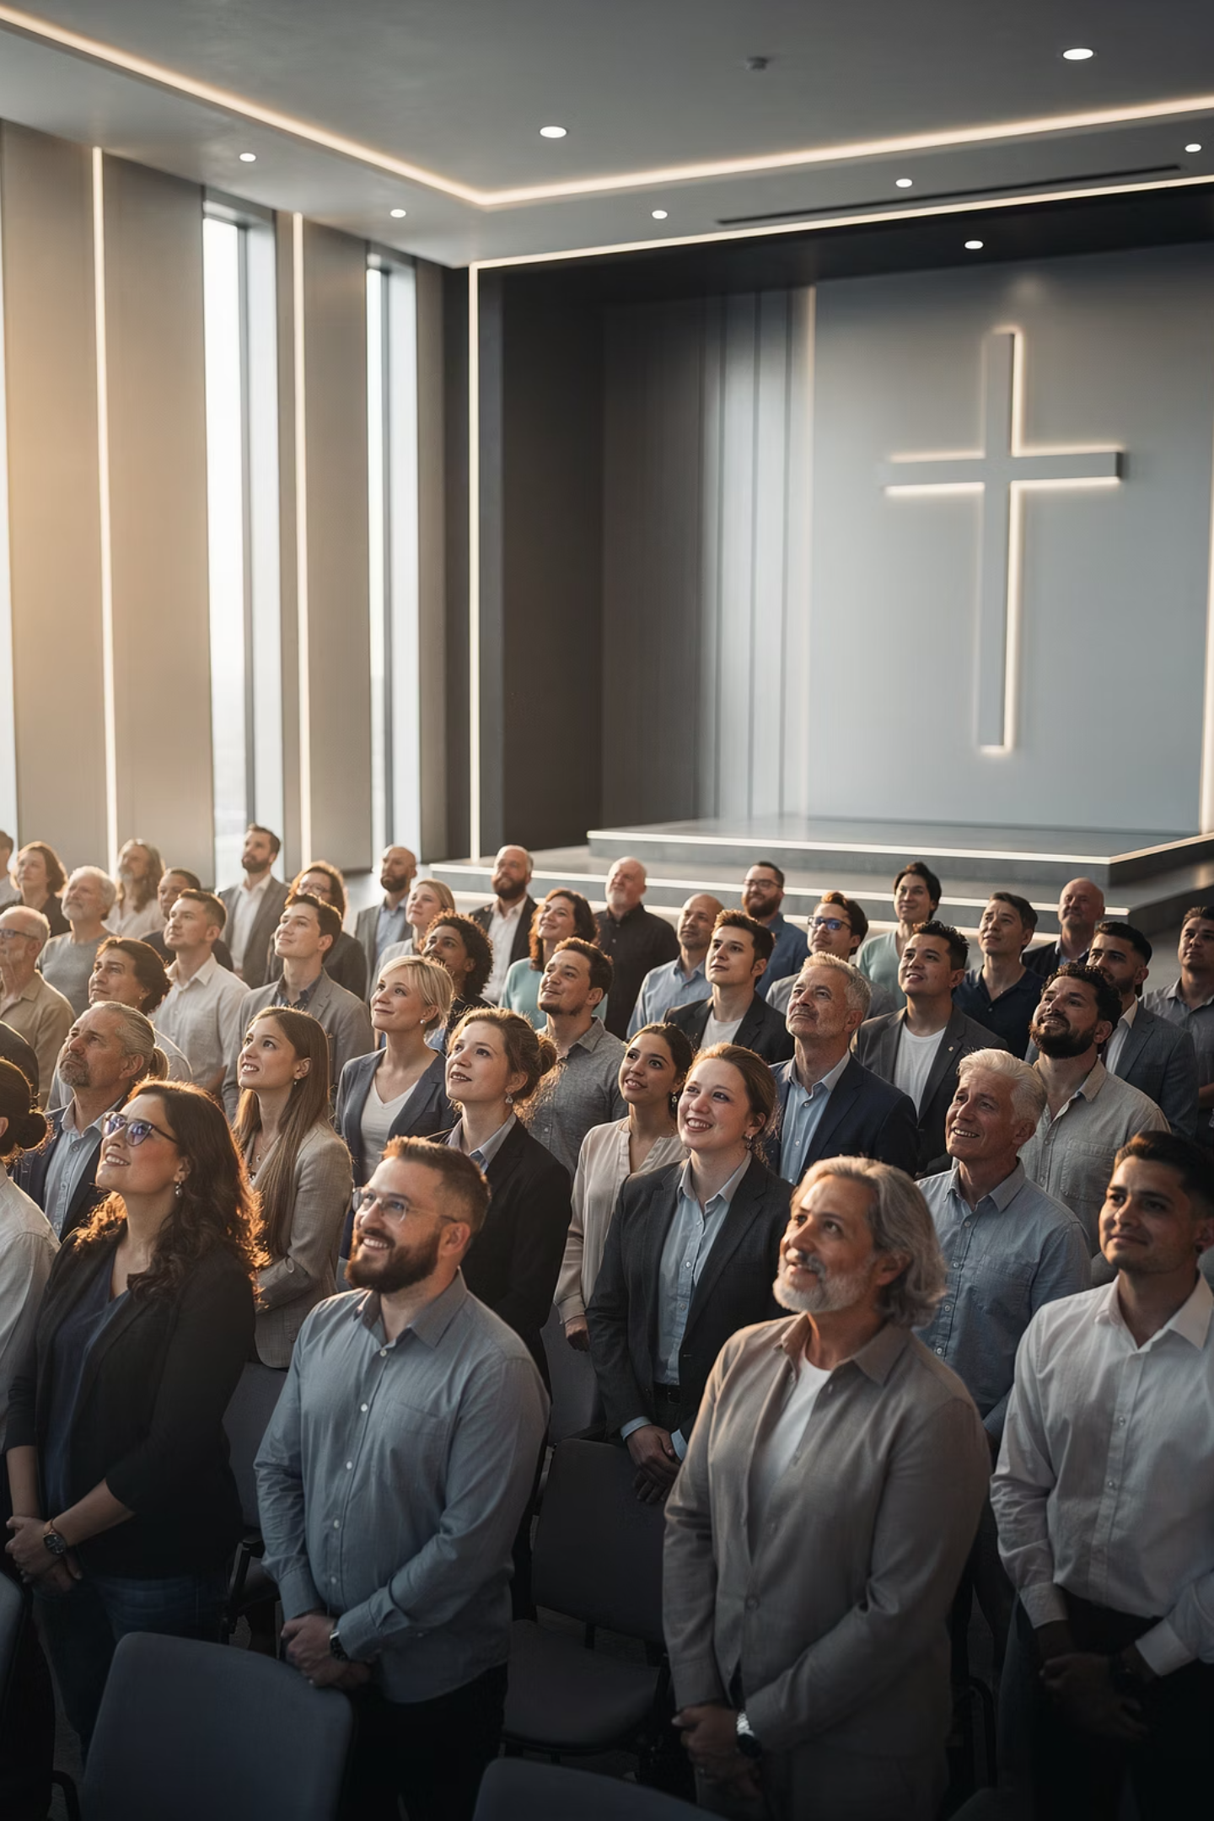

Partners in the Mission of God
The partnership between pastor and administrator is not merely organizational, it is biblical, strategic, and sacred. When both roles are honored, the church is protected from burnout, legal gaps, and operational failure. More than that, it is positioned to grow, flourish, and fulfill the calling God has placed upon it.
"He gave the apostles, the prophets, the evangelists, the shepherds and teachers, to equip the saints for the work of ministry, for building up the body of Christ." Ephesians 4:11-12
Together, one providing direction, the other providing organization, pastor and administrator protect the mission of the Church and ensure it endures for generations to come.

