Slide 1
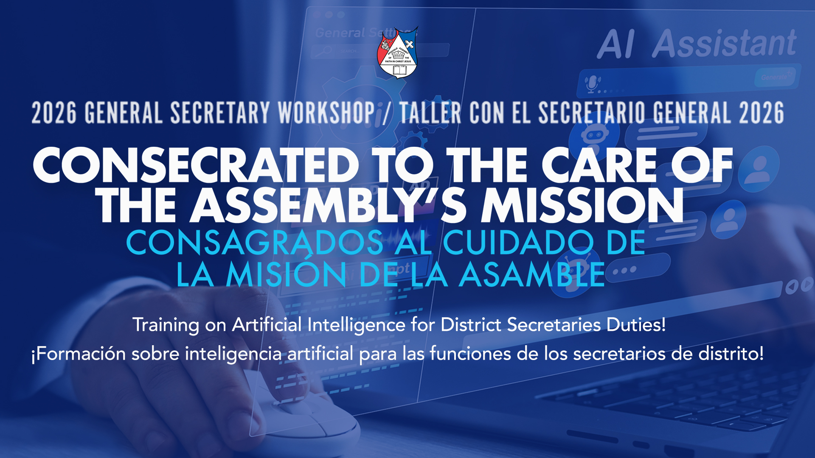

Slide 2
Using Technology to Improve Communication, Organization & Administration
Presented by:
Pastor Israel Carlos
IDCN Secretary

Slide 3
PURPOSE OF THIS PRESENTATION
Technology can help us:
Communicate faster
Stay organized
Reduce administrative workload
Improve professionalism
Save time for ministry
Serve pastors and churches more effectively

Slide 4
TOOLS I PERSONALLY USE:
1. CallMultiplier
2. Google Drive
3. BL.INK
4. OpenAI ChatGPT

Slide 5
MINISTRY ALSO REQUIRES ADMINISTRATION
GOOD COMMUNICATION HELPS:
District unity
Faster response times
Better event coordination
Clear documentation
Accurate reporting
Professional leadership
Notes:
Biblical Principle:
“Let all things be done decently and in order.”
— 1 Corinthians 14:40 (NKJV)

Slide 6
WHAT IS CALLMULTIPLIER?
A mass communication system that allows:
Voice messages
Text messages
Group communication
Emergency notifications
Event reminders

Slide 7
WHAT IS CALLMULTIPLIER?
USED TO COMMUNICATE WITH:
82 pastors in our district
Church Administrators

Slide 8
HOW I USE CALLMULTIPLIER
Practical District Uses:
Event reminders & updates
Board meeting notifications
Ordination & initiation instructions
Emergency announcements
Funeral notifications
District-wide communication

Slide 9
HOW I USE CALLMULTIPLIER
Benefits:
Fast communication
One message reaches everyone
Saves hours of individual texting
Ability to schedule messages days in advance
Ability to send messages by groups
Ability to communicate with English-speaking or Spanish-speaking pastors
Ability to send links or full flyers

Slide 10
EXAMPLE OF A DISTRICT COMMUNICATION
Examples:
I will put links here

Slide 11
Advantages:
Professional
Clear
Immediate
Recorded delivery system

Slide 12
GOOGLE DRIVE
What is Google Drive?
A cloud storage system that allows us to:
Upload files
Organize documents
Share information instantly
Access files from anywhere

Slide 13
FILES I STORE & SHARE
Examples:
Flyers
Videos
Reports
Board minutes
Candidate forms
District calendars
Major Advantage:
One link can instantly provide access to everyone.

Slide 14
USING SHAREABLE LINKS
Process:
1. Upload file to Google Drive
2. Generate shareable link
3. Send link through CallMultiplier
4. Pastors instantly access files
Example Uses:
• Event flyers
Questionnaires
Ministry schedules
Reports
Official letters

Slide 15
WHY I USE BL.INK
The Problem:
• Google Drive links can be long
• Complicated
• Difficult to type
The Solution:
BL.INK shortens and customizes links.

Slide 16
CUSTOMIZED LINKS
Instead of:
A very long and complicated Google Drive URL…
I can create:
b.link/IDCNCalendar
b.link/Ordenacion
b.link/MinisterioPalabra
Notes:
Benefits:
• Cleaner communication
• Easier access
• More professional appearance
• Easier to announce publicly

Slide 17
HOW THE SYSTEM WORKS TOGETHER
Step 1: Create document or flyer
Step 2: Upload to Google Drive
Step 3: Create short BL.INK link
Step 4: Send through CallMultiplier
Result:
82 pastors receive immediate and organized communication.

Slide 18
USING AI AS A DISTRICT SECRETARY
How I use ChatGPT:
Review letters
Improve wording
Organize reports
Prepare agendas
Draft professional responses
Translate documents
Create outlines
Prepare minutes
Assist with communication

Slide 19
REAL EXAMPLES OF USING ChatGPT
Practical District Administration
Example 1:
Retiring pastors submitted letters.
I uploaded the letters and explained:
• The IDCN Board interviewed candidates
• Candidate qualifications
• Ministerial strengths
• Leadership qualities
Result:
ChatGPT helped prepare a professional recommendation letter to the President.

Slide 20
MORE PRACTICAL EXAMPLES
Additional Uses
Uploading Flyers
I upload flyers and explain the event.
Example:
Financial assistance for pastors attending district events.
Result:
Official district letters
Professional wording
English & Spanish versions
Organized formatting

Slide 21
OTHER TASKS CHATGPT HELPS ME WITH
Examples:
District board meeting agendas
Reviewing board minutes
Organizing reports
Preparing announcements
Writing formal communication
Translation assistance
Event planning documents
Leadership presentations

Slide 22
TECHNOLOGY SHOULD SUPPORT MINISTRY
Technology is a tool — not a replacement for:
Prayer
Wisdom
Spiritual discernment
Biblical leadership
Pastoral care
Technology helps us:
Be more effective
Be more organized
Save time
Improve communication

Slide 23
FINAL THOUGHT
The goal is not simply technology.
The goal is effective ministry administration.
“Moreover it is required in stewards that one be found faithful.”
— 1 Corinthians 4:2 (NKJV)
Thank You
Pastor Israel Carlos
IDCN Secretary

