Slide 1

Stewarding God’s House: Administrando la casa de Dios:
The District’s Vital Role in the Real Estate Process
el papel fundamental del distrito en el proceso inmobiliario

Slide 2


PROPERTIES For the purpose of this Article 43, “Property” is defined as real estate with or without improvements, that has been acquired, retained, or used as a place of worship or other religious activities by: (i) members of the local congregation(s), (ii) the local District Office, (iii) the national office of the Apostolic Assembly, and/or (iv) a residence for the local Pastor.
Article 43 – Property Definition

Slide 3
1. Local Member and Local Government Signatures 2. Majority of congregation (50%+1) must sign – must be submitted to the District Board 3. District must review documents submitted, give their decision and record the resolution – submit to RE Department 4. General Board will issue final decision
Constitution Excerpt – Article 43, XI (the 4 step process)

Slide 4

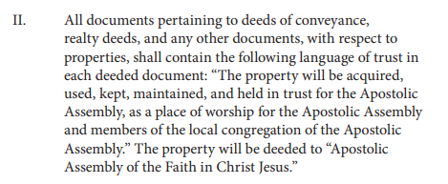
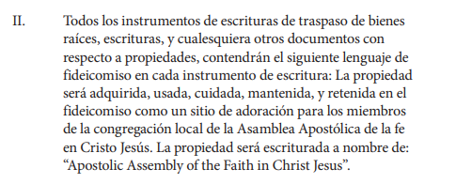
Trust Language – Article 43, II

Slide 5
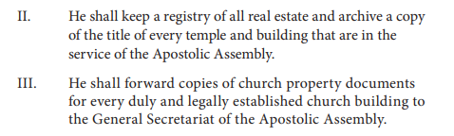
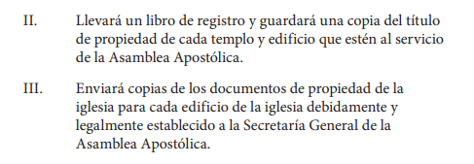
District Secretary Role– Article 64, II & III

Slide 6
Four Reasons why the District’s Role Matters Cuatro razones por las que el papel del Distrito es importante
Protection of the Trust
Order and Unity
Practical Stewardship
Advancement of the Mission
Protección del fideicomiso
Orden y unidad
Administración práctica
Avance de la misión

Slide 7
Four Challenges Cuatro Retos
Know Article 43 inside & out
Train your local Pastors on the 4- step process before any property decision
Document everything
Give Godly, but honest advice to the Pastors
Estudia a fondo el artículo 43
Entrene a sus pastores locales en el proceso de cuatro pasos antes de tomar cualquier decisión sobre la propiedad
Documenta todo
Ofrezcan a los pastores consejos piadosos pero sinceros

Slide 8

Thank you and God Bless Gracias y que Dios los bendiga

