Slide 1

The Biblical Foundations of Holiness
Bishop Felipe A. Salazar
General Pastor, AAFCJ
Notes:
Holiness cannot endure if it lacks theological substance,
Theology provides the essential foundational principles that form the framework explaining why believers are called to live differently from the world.
Without such foundations, holiness is often reduced to mere
external conformity
cultural tradition
institutional expectation
making it vulnerable to rejection and misunderstanding.
The practice of Holiness requires a solid foundation to be transformative.
When holiness is rooted in the:
nature of God
the authority of Scripture
the work of the Holy Spirit
and the believer’s identity in Christ
it gains spiritual depth and enduring meaning.
Foundational truths transform holiness from a burdensome obligation into a joyful response to divine revelation.
Foundational Truths help believers understand that holiness is not arbitrary human regulation, but participation in the character and purposes of God.
In this sense, theology gives holiness its substance, conviction, stability, and beauty.
So Today I want to talk about what makes holiness substantive.

Slide 2

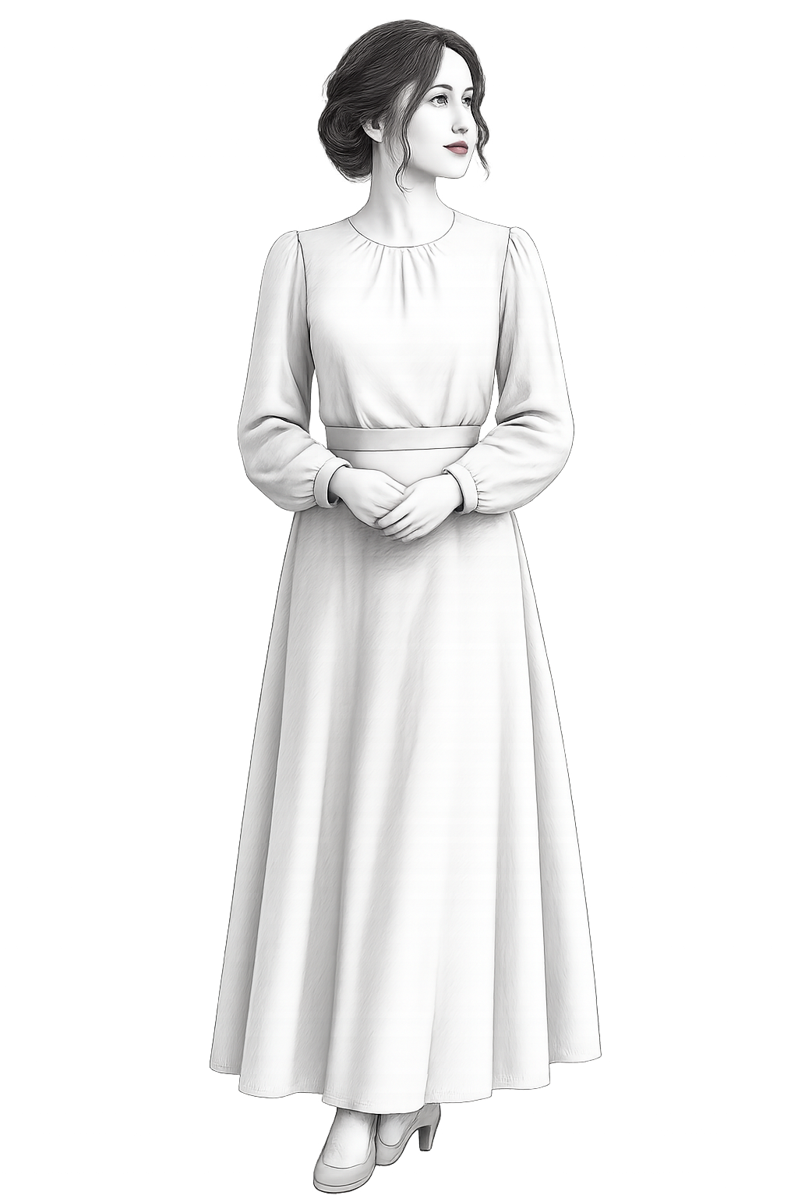

Introduction: The Most Misunderstood Doctrine
The Problem
The Foundation
Many have reduced holiness to a list of rules, external standards, or cultural expectations. Others, reacting against legalism, have abandoned holiness altogether in the name of grace. Both extremes miss the mark entirely.
Scripture brings us back to a foundational truth: Holiness does not begin with us, it begins with God. Before holiness is something we practice, it is something God is. Before it is a command, it is a revelation of His nature.
If we see God correctly, holiness becomes not a burden, but a response.
Notes:
THE PROBLEM
Holiness is one of the most misunderstood doctrines in the Church today. Many have reduced holiness to a list of rules, external standards, or church expectations.
Some, reacting against that, have abandoned holiness altogether in the name of grace.
THE FOUNDATION
But Scripture brings us back to a foundational truth: Holiness does not begin with us—it begins with God.
SECTION THREE
Before holiness is something we practice, it is something God is. Before holiness is a command, it is a revelation of His nature.
If we misunderstand God, we will misunderstand holiness. If we see God correctly, holiness becomes not a burden—but a response.
Without a strong theological foundation, the call to Holiness will face strong resistance when people are asked to be “different” from prevailing cultural mores and norms, especially if the Holiness norms are perceived as merely human conjecture and opinion. A strong theological basis for separateness is necessary for holiness to be fully assimilated and practiced with joy.

Slide 3
Why a Theological Foundation Matters
Without a strong doctrinal foundation, the call to holiness will face fierce resistance, especially when believers are asked to live differently from prevailing cultural norms. If holiness appears to rest on human conjecture alone, it will be dismissed.
The Risk of a Weak
Foundation
The Power of a Strong Foundation
The Goal: Joy-Filled
Holiness
When holiness is perceived as merely a cultural preference or denominational opinion, people have no compelling reason to embrace it. Resistance grows, and compliance, if it comes at all, is hollow and short-lived.
A holiness rooted in the unchanging nature of God carries divine authority. It cannot be argued away by shifting culture. It is embraced not out of obligation but out of genuine awe for who God is.
A strong theological basis for separateness is necessary for holiness to be fully assimilated and practiced with joy — not grudging compliance. Theology transforms duty into delight.

Slide 4

The Call to Holiness Is Rooted in the Nature of God
"But as he which hath called you is holy, so be ye holy in all manner of conversation [life]; Because it is written, Be ye holy; for I am holy." — 1 Peter 1:15–16 (KJV)
Notice the critical order of the text. It does not say: Be holy so that God can be holy. It says: Be holy because God is holy. Holiness is not invented by the Church — it is inherited from God's own character.
God Is the Standard
God Is the Source
God Is the Reason
His nature defines what holiness actually is, not our tradition, not our culture.
We do not generate holiness on our own; we draw it from communion with Him.
The "because" in the text grounds every demand for holiness in divine reality.
Key Truth: We are not called to define holiness, we are called to reflect it.

Slide 5


God's Holiness Defines All True Holiness
To understand holiness rightly, we must first understand who God is. Scripture reveals three dimensions of His holy character that together form the bedrock of all holiness theology.
A. God Is Separate
B. God Is Pure
C. God Is Perfect
"Holy, holy, holy, is the LORD of hosts: the whole earth is full of his glory." Isaiah 6:3
"Thou art of purer eyes than to behold evil…" Habakkuk 1:13
"Be ye therefore perfect, even as your Father which is in heaven is perfect." Matthew 5:48
The triple declaration reveals holiness is not merely one attribute among many, it is the very essence of God's being. He is separate from sin, from corruption, and from all created imperfection.
God does not merely avoid sin — He is incapable of contamination. His purity is not disciplined restraint; it is His unalterable nature.
Holiness is not partial righteousness polished up, it reflects the perfection of God's nature, whole and complete in every respect.

Slide 6
Holiness Is a Reflection, Not an Invention
"So God created man in his own image, in the image of God created he him." — Genesis 1:27 (KJV)
Holiness is not something humanity creates or constructs — it is something we were designed to mirror. From the very beginning, we were fashioned to reflect God's image, and that image includes His holiness. We were not given holiness as a task to accomplish but as an identity to inhabit.
What Sin Did
What Holiness Does
Sin shattered the mirror. It distorted the image of God in humanity, introducing corruption, shame, and separation where there had been beauty, purity, and communion.
Holiness wrought by God's grace through the Spirit — restores the reflection. It is the redemptive work of re-conforming us to the image we were created to bear.

Slide 7

Holiness Begins Internally Before It Manifests Externally
"A new heart also will I give you… And I will put my spirit within you, and cause you to walk in my statutes." — Ezekiel 36:26–27 (KJV)
The great danger of any holiness movement is to reverse the divine order to focus so heavily on external conduct that internal transformation is neglected. God works from the inside out, never the outside in.
External First → Legalism
Internal First → Authentic Holiness
When behavior is policed without heart transformation, the result is performance-based religion. It produces conformity without conviction, and compliance without love.
When God renews the heart through His Spirit, holy living flows naturally outward. Obedience becomes the fruit of a changed life, not a substitute for one.
Key Truth: External holiness without internal transformation produces legalism.
Only Internal transformation produces authentic holiness.

Slide 8



The Holy Spirit (Christ in us) Makes Holiness Possible
"…God hath from the beginning chosen you to salvation through sanctification of the Spirit and belief of the truth." — 2 Thessalonians 2:13 (KJV)
Holiness is not human effort straining toward a divine ideal, it is divine empowerment meeting sincere surrender. God does not command what He does not enable. He never calls us to a standard He refuses to supply the grace to reach.
He Calls Us
He Fills Us
He Sustains Us
The divine call to holiness is clear, authoritative, and personal. "Be ye holy" is not a suggestion, it is a calling.
The same God who commands holiness sends His Spirit to dwell within us, sanctifying, purifying, and empowering from the inside.
Holiness is not a one-time crisis, it is a sustained walk in the Spirit, continually empowered by His presence and grace.

Slide 9
Holiness Affects All Areas of Life
"…so be ye holy in all manner of conversation." — 1 Peter 1:15 (KJV)
The word "conversation" in the KJV does not refer merely to speech — it encompasses the entirety of one's conduct, lifestyle, and daily behavior. Holiness is not compartmentalized. It is not reserved for Sunday worship and suspended Monday through Saturday.
Speech & Relationships
Thoughts & Priorities
Decisions & Appearance
What we say and how we treat others must bear the mark of a holy God — truthful, gracious, and loving.
Holiness governs the inner life — guarding the mind, ordering desires, and aligning our priorities with God's kingdom.
Every choice, including how we present ourselves to the world, becomes a witness, a living statement, nor primarily of who we are, but of whose we. are.
Key Truth: If God is holy in His nature, His people must be holy in their living — in every sphere, without exception.

Slide 10

Holiness is a Response of Love, Not Mere Obligation
"We love him, because he first loved us." — 1 John 4:19 (KJV)
What Holiness Is Not
What Holiness Is
Cold, dutiful obedience is performed to avoid punishment
Forced compliance with an external code
A transaction, holiness offered in exchange for God's approval
A loving response to a God who loved us first
A reflection of an intimate, transforming relationship
The natural fruit of a heart that has truly seen and known Him
We do not pursue holiness to earn God. We pursue holiness because we know Him and knowing Him changes everything.

Slide 11
Holiness Is the Foundation of a Healthy Church
"…holiness, without which no man shall see the Lord." — Hebrews 12:14 (KJV)
A church cannot be spiritually healthy if it loses its commitment to holiness. Leadership cannot carry lasting authority or sustain genuine anointing without personal purity. These are not ideals — they are biblical imperatives.
Holiness Protects Integrity
Holiness Sustains Authority
Holiness Preserves the Anointing
Leaders who walk in holiness are guarded from the moral failures that have shipwrecked ministries and devastated congregations.
True spiritual authority flows not from position or gifting alone but from a life set apart — a life that heaven recognizes and blesses.
The Spirit of God rests where there is purity. A church marked by holiness is a church that remains a vessel fit for the Master's use.

Slide 12
Holiness Begins With God
Holiness Does Not Begin With…
Holiness Begins With God Himself
Dress codes or external standards
Religious rules and regulations
Cultural expectations of any era
Holy in His nature
Pure in His character
Perfect in His being
These things have their place, but they are downstream — they are never the source.
And from that unshakeable reality, He calls every one of His people: "Be ye holy; for I am holy."
If we truly see God, we will not resist holiness. We will pursue it. Because holiness is not losing
Something, it is becoming like Him.
Holiness is not what we do to reach God. Holiness is what we become when we truly see Him.

Slide 13

We are Called to Reflect His Holiness
(Seperateness)
"But as he which hath called you is holy, so be ye holy in all manner of conversation; Because it is written, Be ye holy; for I am holy." — 1 Peter 1:15–16 (KJV)

Slide 14
I Peter 1:15
The Command Is Grounded in God's Character
ISaiah 6:1–3 — The Throne Room Vision
"Holy, holy, holy, is the LORD of hosts: the whole earth is full of his glory." — Isaiah 6:3 (KJV)
Notice carefully what God does not say. He does not say, "Be holy because your church is holy." He does not say, "Be holy because your pastor is holy." He says with unmistakable clarity: "Be ye holy; for I am holy." The source of the command is the character of God Himself.
Holiness does not begin with culture, preference, the Church, or organizational policy. Holiness begins with God, and flows outward from Him to His people, His Church, and the world He is redeeming.
Notes:
When the prophet Isaiah was granted a vision of the throne of God, the angelic beings surrounding that throne did not cry,
"Love, love, love", though God is love.
"Power, power, power”, though God is all-powerful.
They cried with thunderous, unceasing proclamation: Holy, Holy, Holy!
The triple repetition, a Hebrew superlative, declares that holiness is not merely one attribute among many. Holiness is the central, defining, consuming reality of who God is. Every other attribute of God — His love, His justice, His mercy — flows from and is shaped by His holiness.
To build a theology of the Christian life on any other foundation than the holiness of God is to build on sand.
The Church's call to separation, its standards of conduct, its visible distinctiveness, stands or falls on this one great truth: God is holy.
When that truth grips the heart of a believer, holiness stops being a burden and becomes a beautiful belonging.

Slide 15

Holiness Must Affect Outward Conduct
First Peter 1:15 does not command an invisible, purely inward transformation. It commands holiness "in all manner of conversation" — a word that in the original Greek (anastrophē) encompasses the totality of one's conduct, lifestyle, and outward behavior. Holiness is not a secret kept in the heart. Holiness is a reality displayed in the life.
What "Conversation" Encompasses
Speech
Words shaped by grace and truth, free from corruption and falsehood.
Peter's command is comprehensive. There is no compartment of life that holiness does not touch, no arena of human behavior that escapes its claim. The command is not, "Be holy in your private prayers." The command is, "Be holy in all manner of conversation" — in every context, every relationship, every decision, every moment of every day.
Attitude
A spirit of humility, gratitude, and submission before God and others.
Relationships
Realtionships governed by purity, love, and faithfulness.
Appearance
A presentation that reflects the values of modesty and sobriety.
Holiness is not merely what happens on the inside. It is the inside made visible. When God truly inhabits a life, that life begins to look different. The inner transformation produces outward evidence that cannot be hidden or suppressed.
Lifestyle
Daily patterns, habits, and choices oriented toward God's glory.
Notes:
This is both the glory and the weight of the call to holiness. It is a total-life transformation, not a partial adjustment. It does not ask for Sunday morning compliance and weekday compromise. It asks for the whole person — surrendered, consecrated, and bearing the family resemblance of a holy God.

Slide 16
Biblical Principles and the Spirit of Modesty
The Apostolic Assembly does not teach holiness standards as arbitrary rules invented by religious hierarchy. Rather, Scripture itself establishes clear, enduring principles that the Church is called to honor and apply. These principles form the theological foundation upon which every holiness practice stands. Understanding these foundations transforms how believers relate to holiness standards — from reluctant compliance to wholehearted embrace.
Modesty
Separation from Vanity
Sobriety and Purity
Scripture consistently calls His people to dress in a manner that reflects humility rather than drawing attention to the body.
1 Timothy 2:9–10 instructs women to adorn themselves with "modest apparel, with shamefacedness and sobriety."
The Greek word for shamefacedness speaks of a disposition of reverence, an awareness of being seen by God.
Modesty is not about fabric alone; it is about the spirit that chooses how to present oneself before God and to the world.
1 Peter 3:3–4 draws a direct contrast between outward adornment and the hidden person of the heart.
The Apostle Paul was not forbidding all personal care; he was establishing a priority.
The cultivation of a gentle and quiet spirit, takes precedence over the cultivation of outward manifestations.
The Apostolic position regarding jewelry and ostentatious adornment flows from this desire to cultivate modesty, humility, and separation from worldly vanity.
The biblical call to sobriety (sōphrosynē) encompasses sound-mindedness, self-discipline, and freedom from excess.
God's people are called to live with a clear-eyed, sober awareness of who they are and whom they serve.
Purity of body, mind, and spirit, is not optional for the believer. It is woven into the very fabric of what it means to be holy.
These two virtues, sobriety and purity, guard the believer against the drift that inevitably comes when cultural currents are not consciously resisted.

Slide 17
Leadership, Authority, and Love as the Motive for Holiness
"Obey them that have the rule over you, and submit yourselves: for they watch for your souls, as they that must give account…" — Hebrews 13:17 (KJV)
This structure is not religious authoritarianism. It is the biblical pattern of shepherding care. Pastors and church leaders bear a profound accountability before God for the spiritual wellbeing of those entrusted to their care. Their application of holiness principles is not an exercise of power for its own sake — it is an expression of pastoral love and spiritual vigilance. The congregation is invited to extend trust not merely to the person of the leader, but to the God-ordained office and the Spirit who guides it.
Love Is the Motive — John 14:15
Separation Unto God — Not Merely Away From the World
Reflection of His Nature
"If ye love me, keep my commandments." Jesus did not say, "If you fear me" or "If you want to avoid punishment." He said, "If you love me."
Holiness rooted in love for God is transformative. It does not experience obedience as bondage, it experiences obedience as intimacy.
Every act of separation, every choice of modesty, every exercise of sobriety becomes an act of devotion offered to the One who is altogether holy and altogether worthy.
As children bear the image of their parents, the children of God are called to bear the image of their heavenly Father, who is holy.
This is not a burden imposed from outside. It is a destiny written into the new nature given at the new birth.
The Spirit of holiness dwelling within the believer is always pressing, always urging, always inviting toward greater conformity to the character of God.
It is crucial to understand that biblical holiness is not primarily a movement away from something, it is a movement toward Someone.
Holiness is separation unto God.
This reframes the entire message of holy living. The question is not only, "What must I give up?" The question is, ” To Whom am I drawing near?"
When love for God is the engine of obedience, the standards of holiness become expressions of relationship rather than requirements of religion.
Notes:
One of the most important distinctions in understanding Apostolic holiness is grasping the relationship between biblical principles and their application by spiritual leadership.
The Bible establishes enduring principles: modesty, sobriety, separation, gender distinction, purity.
Spiritual leadership, under the guidance of the Holy Spirit and accountable to the Word of God, then applies those principles within specific cultural and historical contexts to preserve a clear witness of separation unto God.

Slide 18

When Holiness Becomes Worship
His Church Must Be Distinct
His People Must Be Holy
God Is Holy
The command is clear and comprehensive: holiness in all manner of conversation, in every dimension of life and conduct.
The witness is visible and urgent, a separated people shining as lights in the midst of a dark and searching world.
The foundation is fixed and immovable..
"When the holiness of God becomes real to the heart, separation from the world no longer feels like bondage — it becomes an act of worship."

